Slide 1
Java Workshops 2 – Big data
This is a big idea.
Ben Schwarz

Slide 2
Lesson Outline
Non-Primitive Data Types - String
Using Classes for Primitive Data Types
Call Methods on String data types to use information from them
Inputting from the user
Using the Math Class

Slide 3
Revisiting the “char” type
Hold a single Unicode character, e.g. ‘c’
Represented by a number from 0 to 2¹⁶ - 1. This means
‘c’ - ‘a’ is a valid operation, resulting in 2
‘c’ + ‘a’ will not result in a String equal to “ca”
‘c’ > ‘a’ is true
‘a’ - ‘A’ is 32 – see the ASCII table
*It is based on the original Unicode specification meaning that emojis will not work and as such chars should be avoided

Slide 4





Hello World!
Up to this point, we’ve just been printing only numbers and booleans. What if we want to print text, like saying “Hello World”?
We use a String data type:
This is the first complex (non-primitive) data type we’ve seen. It has an uppercase letter to begin, and isn’t coloured purple. This means that methods can be called on it, which use its data to do something.
Primitive types store only a single value. They are:
All lowercase
Coloured purple in Eclipse
Complex data types can store more information. They are:
Written in CamelCase
Coloured black in Eclipse
Methods that act on this data can be accessed with the “.” operator.

Slide 5
String-indepth
A Java String contains an immutable sequence of Unicode characters. Unlike C/C++, where string is simply an array of char, A Java String is an object of the class java.lang.
Java String is however, special – not an ordinary class:
String is associated with string literal in the form of double-quoted texts such as "Hello, world!". You can assign a string literal directly into a String variable, instead of calling the constructor to create a String instance.
The '+' operator is overloaded to concatenate two String operands. '+' does not work on any other object such as Point and Circle.
String is immutable. That is, its content cannot be modified once it is created. For example, the method toUpperCase() constructs and returns a new String instead of modifying its existing content.

Slide 6
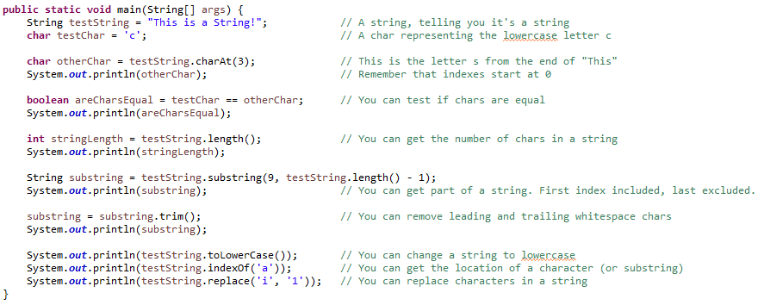
String Methods
There are more methods that can be called on Strings than just the ones above – explore the list of suggestions Eclipse gives you when you type the dot operator, or use “ctrl + space”.

Slide 7


Classes for Primitive Data Types
The char data type can’t contain methods, but there is a class with its own functions to work with chars - Character.
To use these functions, we have to pass in the char as a parameter, because we are not calling them on the char itself.
The other primitive types have their own classes, which are usually their full name, capitalised, e.g. int has an Integer class.

Slide 8
Methods vs Functions
These terms are often used interchangeably, including by myself. However, in technical terms, functions are not called on an object, while methods are.
Character.someFunction(…) is a function. It is located in the Character class.
someString.someMethod(…) is a method. It is called on someString, and should use the data someString contained – otherwise it could be a function in String.
Note that for the moment, the distinction between objects and classes isn’t too relevant. When we start making our own in a few weeks, we’ll revisit this concept.
Function call:
ClassName.functionName(...);
Method call:
variableName.methodName(...);
Methods can only be called on variables – calling them on a class will cause an error.
Though it will only cause a warning, don’t call a function on a variable. There’s no reason to not use the class.

Slide 9
Exercises
Print the position in the alphabet of a given lowercase letter, e.g. ‘c’ should result in 3 being printed.
Print “This is not a String” by using a String equal to “This is a String” and each of:
The substring method, and addition of strings
A replace method (try replacing “is” with “is not”
Count by hand the number of ‘i’s’ in the above string, and then print a double representing the percentage of chars that are ‘i’
Create double “num” and assign a value. Then output a hexadecimal String (using the Double class)
You may have to explore other functions and methods by typing ‘.’ after an object or class and scrolling through Eclipse’s suggestions.
Don’t try to count the ‘i’s in Q3 programmatically. We’ll learn how to do that in a later workshop.

Slide 10
Creating a Scanner
Java comes with code to read from the console in the “Scanner” class,
Create a new variable of type “Scanner”, with the value of a new Scanner instance.
Done in a similar way to an integer, string or other object.
Example:
This creates a new variable, of type Scanner, called keyboardInput, and sets its value to… a new Scanner. We need to give Scanner some information, which is what we want to scan. Thus we give it “System.in” (The console).

Slide 11
Importing
Have you noticed some red squiggly lines below “Scanner”. That’s because, although Java has code for a Scanner, we haven’t told it we want to use that code.
Not to fear; Simply hover over the word Scanner, and click “import Scanner(Java.util).” This will conveniently import the code for a Scanner into your code.
Now to do some scanning…

Slide 12
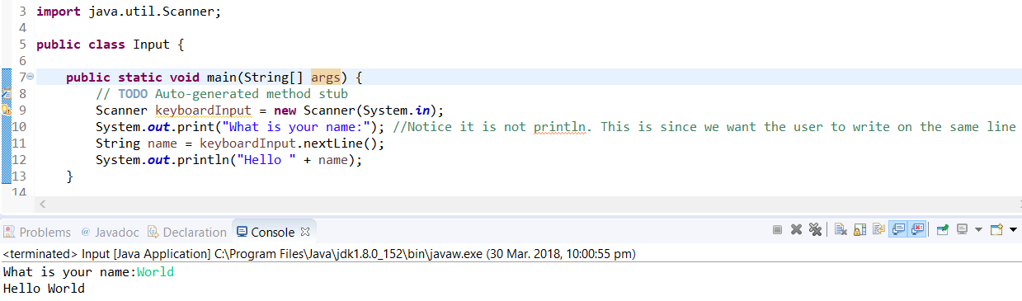
Example
Calling “keyboardInput.nextLine()” will return a String of what has been typed into the console. Take a look at this example code:

Slide 13

Notice the yellow squiggly line?
That is because we haven’t closed the keyboard.
When using the scanner class you should always close.
For e.g. if you are reading from a file and your application is finished reading but you forget to call close no other application can read the file
Calling the close method disconnects the Java program from the computer keyboard.
The Java Virtual Machine usually cleans up if you forget for a keyboard but it is good practise and you should do it.
The bottom example is the correct version you should always use.

Slide 14
Activities:
Write the previous program which asks a user for their name (inputted on the same line) and then outputs “Hello” followed by their name.
Change print to println. See what happens. (Then change it back)
Ask someone their first and last name. Then impersonate them James Bond style (e.g. if they gave "James" and "Bond", say "The name's Bond. James Bond.").
Ask someone their favorite number. Respond with a number twice as big as theirs.
Let a user input 2 numbers and find the remainder. (You can ask for the numbers separately).
Technical note:
"nextLine" returns a String, but here you want a number. if you type "scan." then press "Ctrl + Space" eclipse will show you a list of all the different methods (things) a Scanner can do. There's a lot, but if you type in "next" it will only show you functions that start with "next", cutting down the list to only useful things. You can use the arrow keys to scroll up and down the list, and hit enter to select your option.

Slide 15
The Math class
The same way we can access integer functions by calling Integer.fancyFunction();
We can access maths functions by calling Math.fancierFunction();
double areaCircle = Math.pow(3, 2)*Math.PI;

Slide 16
Homework:
Write code to input the diameter of a circle and then output the area of the circle.
Have someone input the hypotenuse of a right angle triangle and a angle(not being the 90) and tell them the other two sides and the opposite angle. (Note Java uses radians not degrees so you will need to convert using functions in the maths class).
Input 2 numbers from the user. Apply the first to the power of the second and then output, “The new number is:” (theOutput).

Slide 17
Summary
Understand strings and chars.
Call the functions for the primitive data type classes as well as other classes.
Input Data from the user
Use the math class

